Slide 1
SMART INVENTORY AND ORDER MANAGEMENT SYSTEM
SOHAM CHATTERJEE
VELLORE INSTITUTE OF TECHNOLOGY
CHUBB AET JAVA FSD

Slide 2
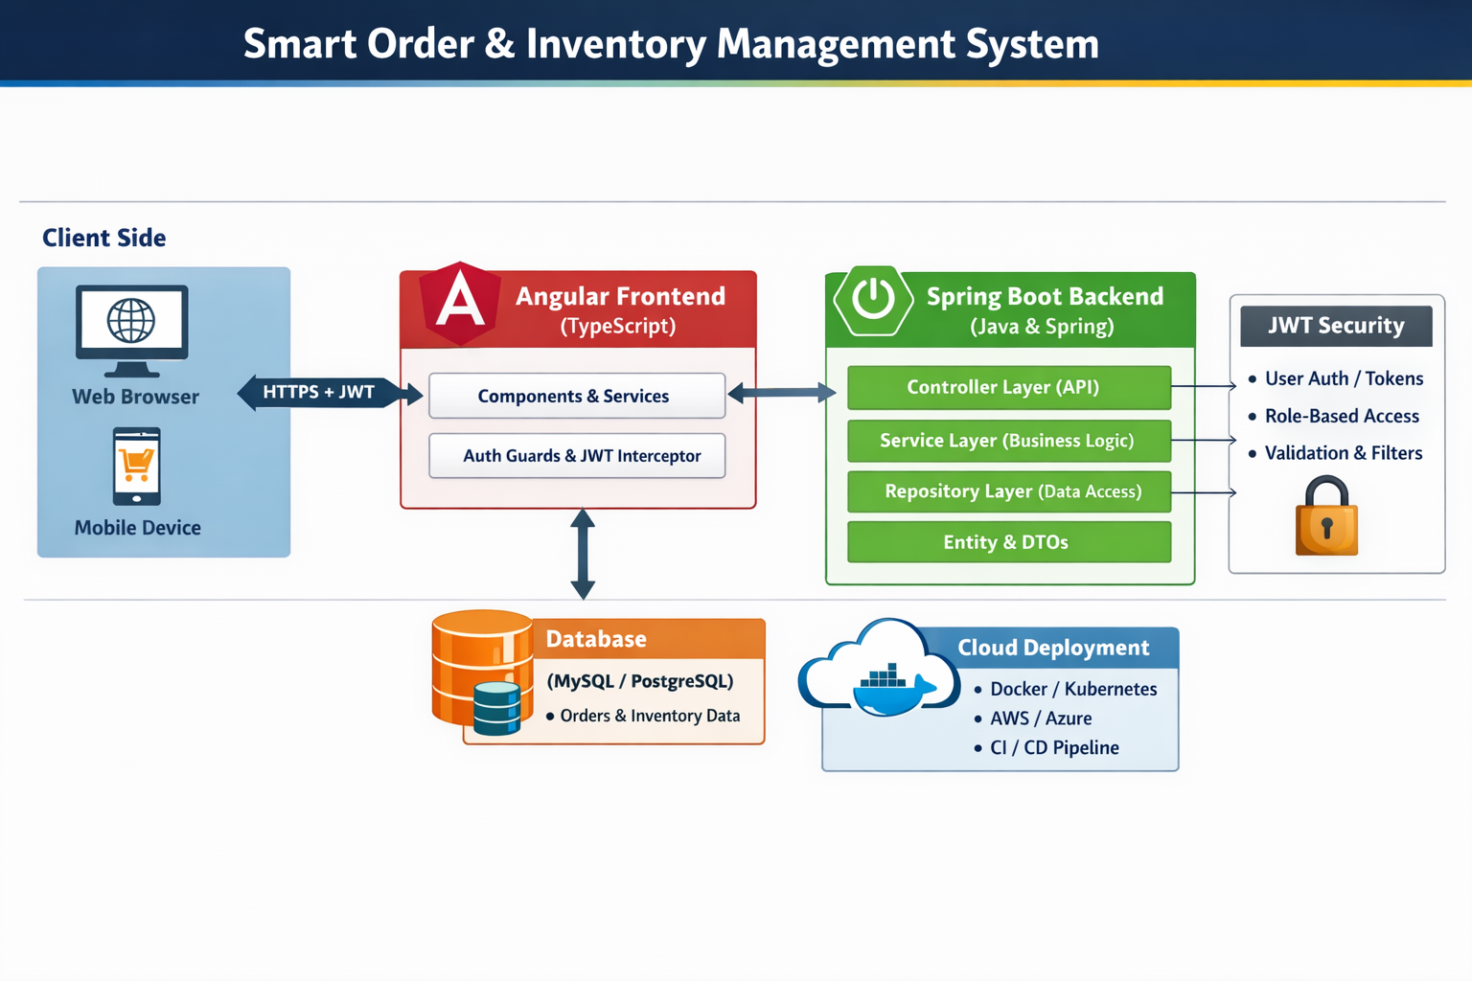
ARCHITECTURE DIAGRAM

Slide 3
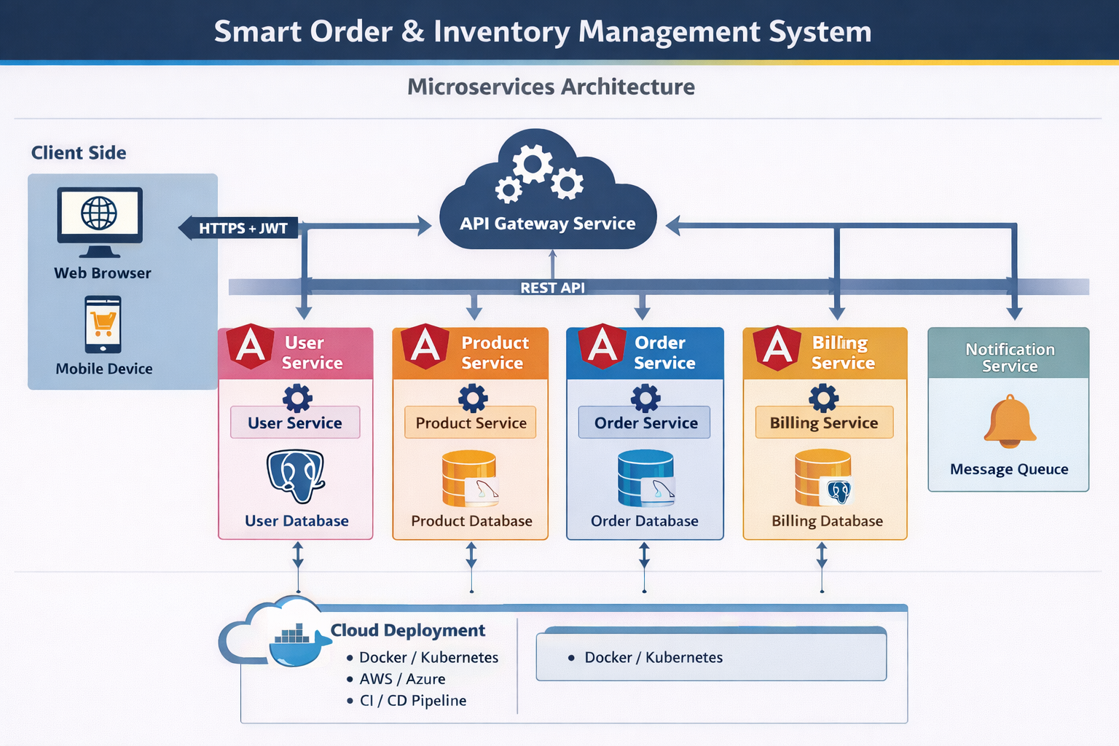

Slide 4
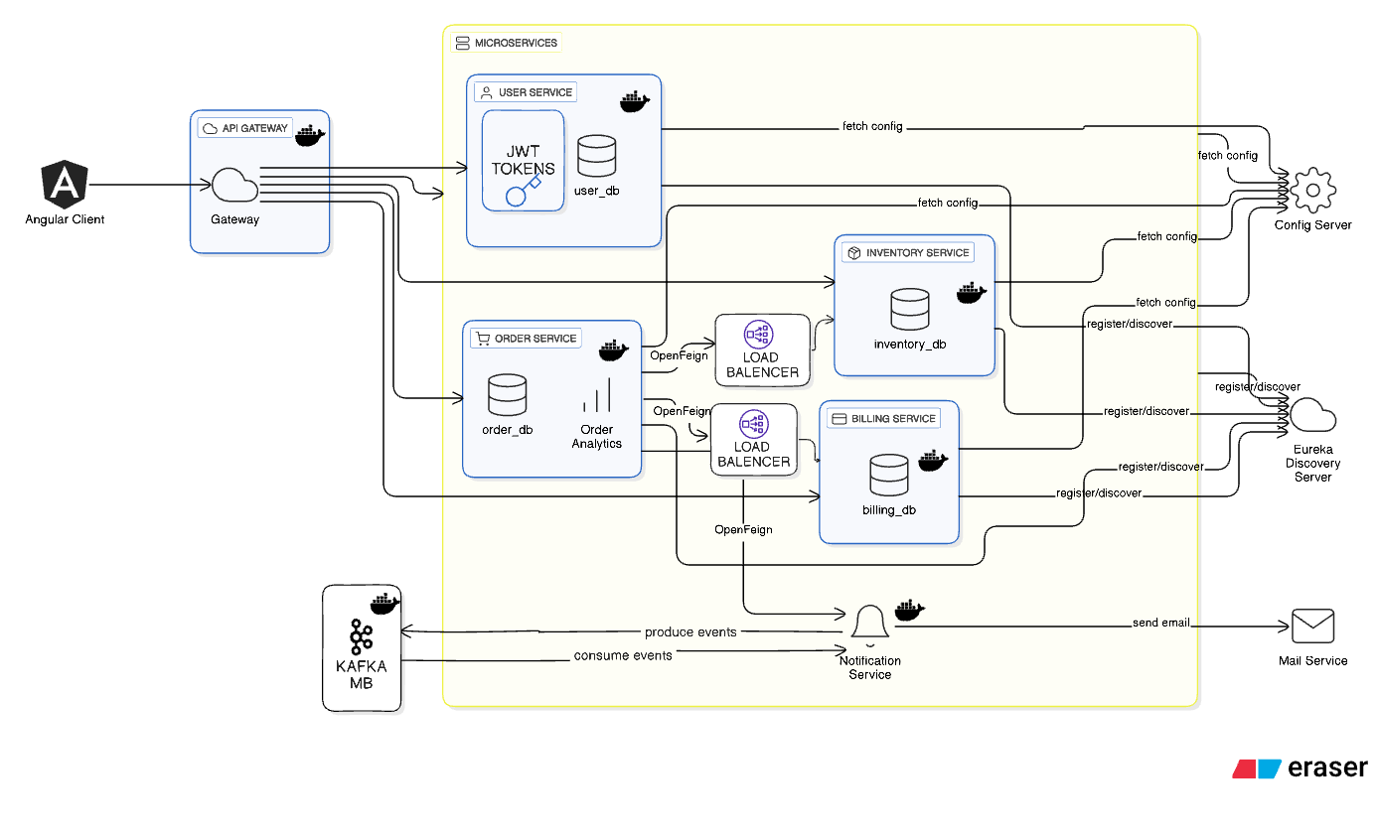
SYSTEM DESIGN ARCHITECTURE

Slide 5
ER DIAGRAM
User Service Database
User attributes:
- id (PK, bigint)
- username (varchar, unique)
- email (varchar, unique)
- password (varchar)
- role (enum: ADMIN, USER, SALES_EXEC, WAREHOUSE_MANAGER, FINANCE)
- active (boolean)
- created_at (datetime)
Relationships:
- No foreign keys to other services
- User is standalone

Slide 6
INVENTORY SERVICE DATABASE
Entities:
- Product
- Warehouse
- Inventory
Product attributes:
- id (PK, bigint)
- name (varchar)
- category (enum)
- price (decimal)
- active (boolean)
Warehouse attributes:
- id (PK, bigint)
- name (varchar)
- location (varchar)
Inventory attributes:
- id (PK, bigint)
- product_id (FK → Product.id)
- warehouse_id (FK → Warehouse.id)
- total_quantity (int)
- available_quantity (int)
- reserved_quantity (int)
low_stock_threshold (int)
Relationships:
- Product 1 → * Inventory
- Warehouse 1 → * Inventory
- Unique constraint on (product_id, warehouse_id)

Slide 7
Billing Service database
Invoice attributes:
- id (PK, bigint)
- order_id (bigint) [external reference]
- user_id (bigint)
- warehouse_id (bigint)
- total_amount (decimal)
- created_at (datetime)
InvoiceItem attributes:
- id (PK, bigint)
- invoice_id (FK → Invoice.id)
- product_id (bigint)
- product_name (varchar)
- category (varchar)
- quantity (int)
- unit_price (decimal)
Relationships:
- Invoice 1 → * InvoiceItem

Slide 8
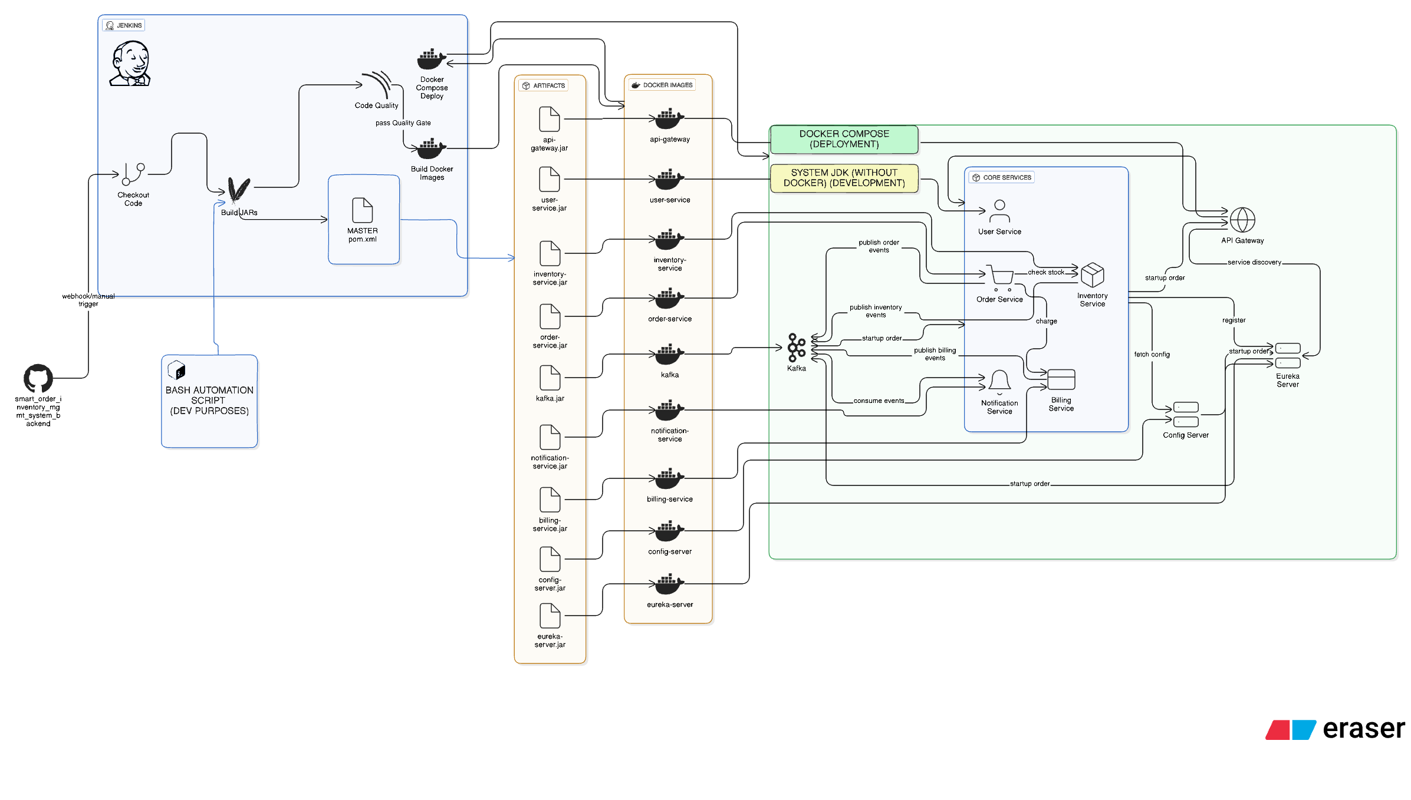
CI/CD AUTOMATION FLOW DIAGRAM

Slide 9
API DESIGN DOCUMENTATION
API | Method | Purpose | Request Body / Params | Response | Auth
/users/register | POST | Register new user | { username, email, password, role } | 201 Created → UserResponse | Public
/users/login | POST | Login using username OR email | { credential, password } | { token } (JWT) | Public
/users | GET | List all users | — | List<UserResponse> | ADMIN
/users/{id}/activate | PUT | Activate user | Path: id | 204 No Content | ADMIN
/users/{id}/deactivate | PUT | Deactivate user | Path: id | 204 No Content | ADMIN

Slide 10
INVENTORY SERVICE
API | Method | Purpose | Request | Response | Auth
/products | POST | Create product | { name, category, price } | { id } | ADMIN
/products | GET | List products | — | List<Product> | Public
/products/{id} | GET | Get product | Path: id | Product | Public

Slide 11
API | Method | Purpose | Request | Response | Auth
/inventory | POST | Add stock to warehouse | { productId, warehouseId, quantity, lowStockThreshold } | { inventoryId, availableQuantity } | ADMIN
/inventory/reserve | POST | Reserve stock (order created) | { orderId, warehouseId, items[] } | 200 OK | Internal
/inventory/release | POST | Release stock (order cancelled) | { orderId } | 200 OK | Internal
/inventory/commit | POST | Commit stock (order shipped) | { orderId } | 200 OK | Internal

Slide 12
ORDER SERVICE API
API | Method | Purpose | Request | Response | Auth
/orders | POST | Create order | CreateOrderRequest | 201 → OrderResponse | USER
/orders/user/{userId} | GET | User order history | Path: userId | List<OrderDetailedResponse> | USER
/orders/{orderId}/status | GET | Order status | Path: orderId | OrderSummaryResponse | USER
/orders/{orderId}/cancel | PUT | Cancel order | Header: X-USER-ID | 204 No Content | USER

Slide 13
API | Method | Purpose | Request | Response | Auth
/admin/orders | GET | Get all orders | — | List<OrderDetailedResponse> | ADMIN
/admin/orders/status/{status} | GET | Orders by status | Path: status | List<OrderSummaryResponse> | ADMIN
/admin/orders/{orderId}/status/{status} | PUT | Update order status | Path params | OrderStatusResponse | ADMIN

Slide 14
BILLING SERVICE API
API | Method | Purpose | Request | Response | Auth
/billing/invoice | POST | Create invoice | { orderId, userId, warehouseId, items[] } | { invoiceId } | Internal
/billing/invoice/{orderId} | GET | Get invoice by order | Path: orderId | InvoiceResponse | ADMIN

Slide 15
API | Method | Purpose | Response | Auth
/admin/analytics/kpis | GET | Total orders & revenue | { totalOrders, totalRevenue } | ADMIN
/admin/analytics/status-count | GET | Orders per status | [{ status, count }] | ADMIN
/admin/analytics/warehouse-count | GET | Orders per warehouse | [{ warehouseId, count }] | ADMIN
/admin/analytics/daily-orders | GET | Orders per day | [{ date, count }] | ADMIN

Slide 16
NOTIFICATION SERVICE API
API | Method | Purpose | Request | Response
/notifications/order-placed | POST | Publish order placed event | OrderPlacedEvent | "Order notification sent"

Slide 17
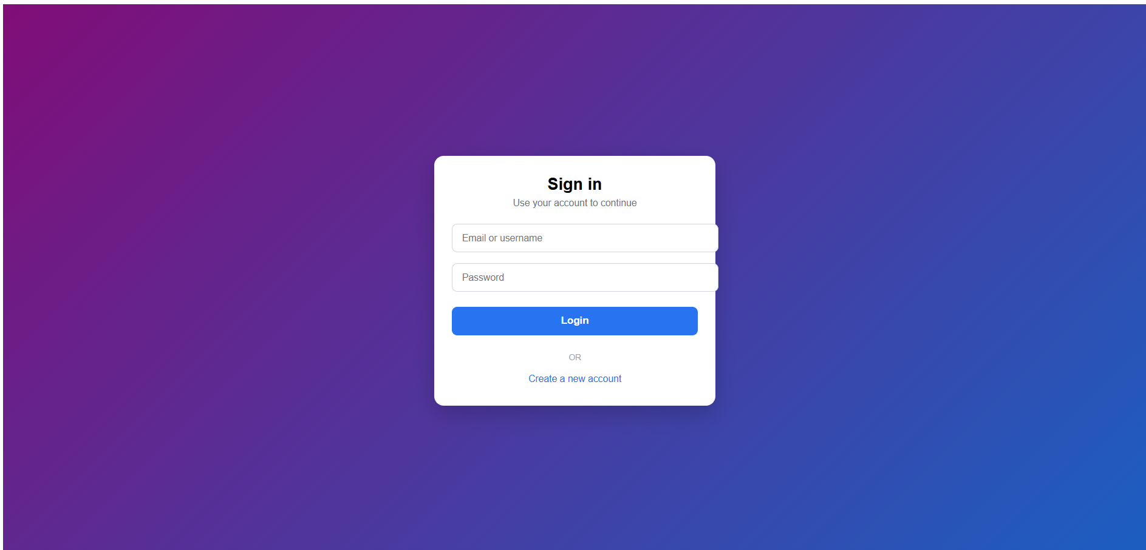
WIREFRAMES AND WORKING APPLICATION

Slide 18
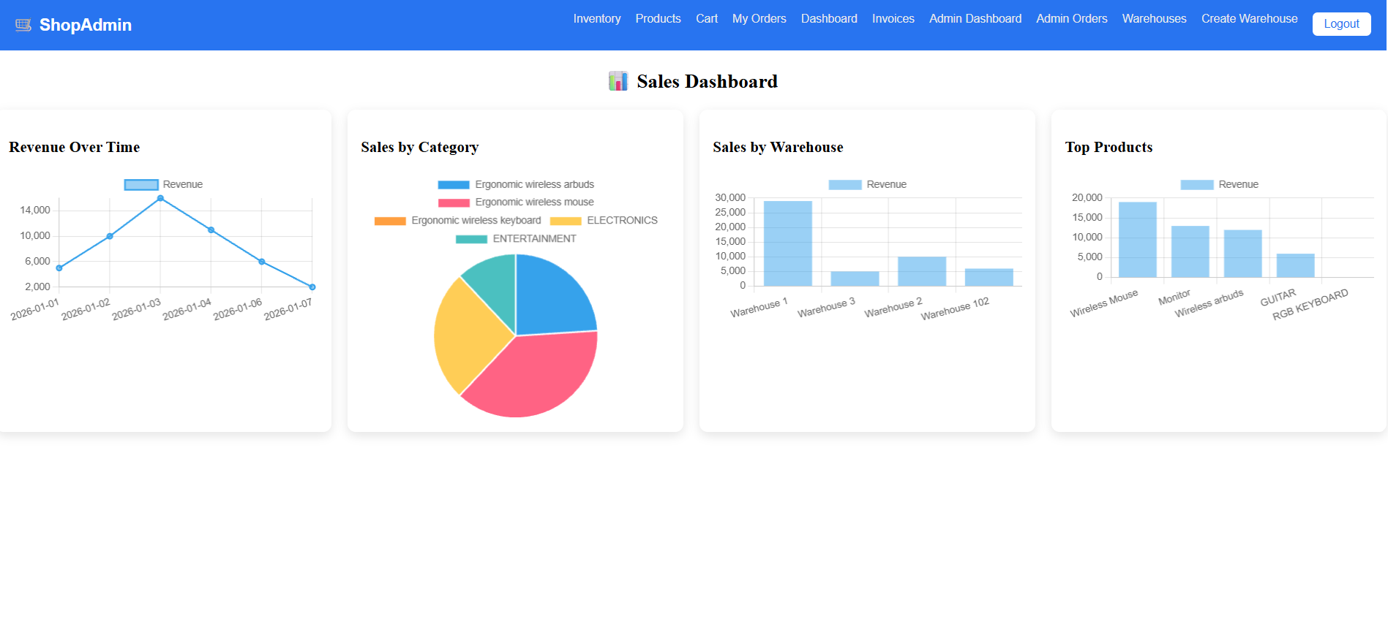
SALES DASHBOARD

Slide 19
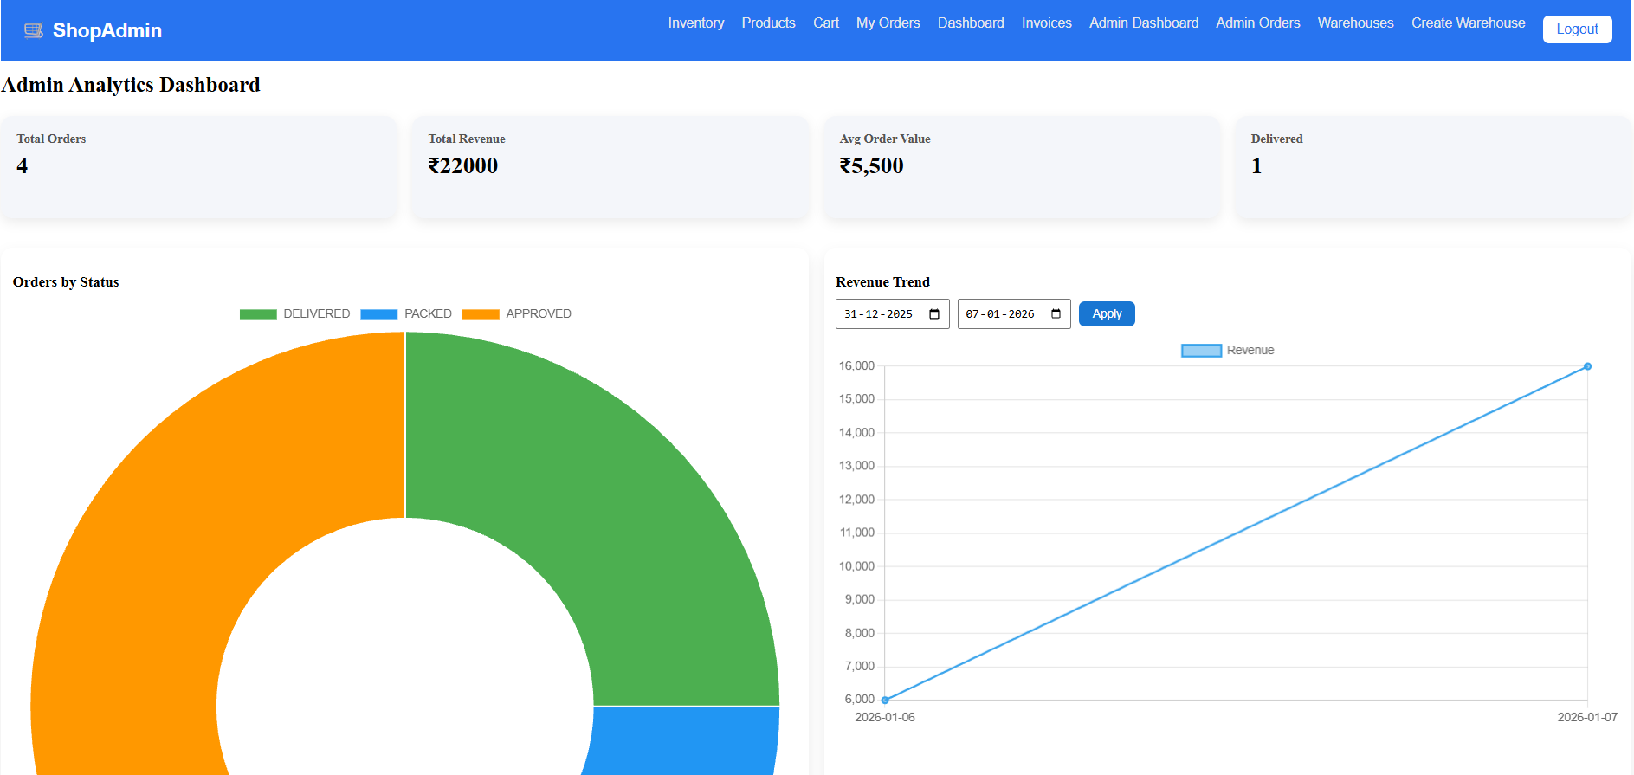
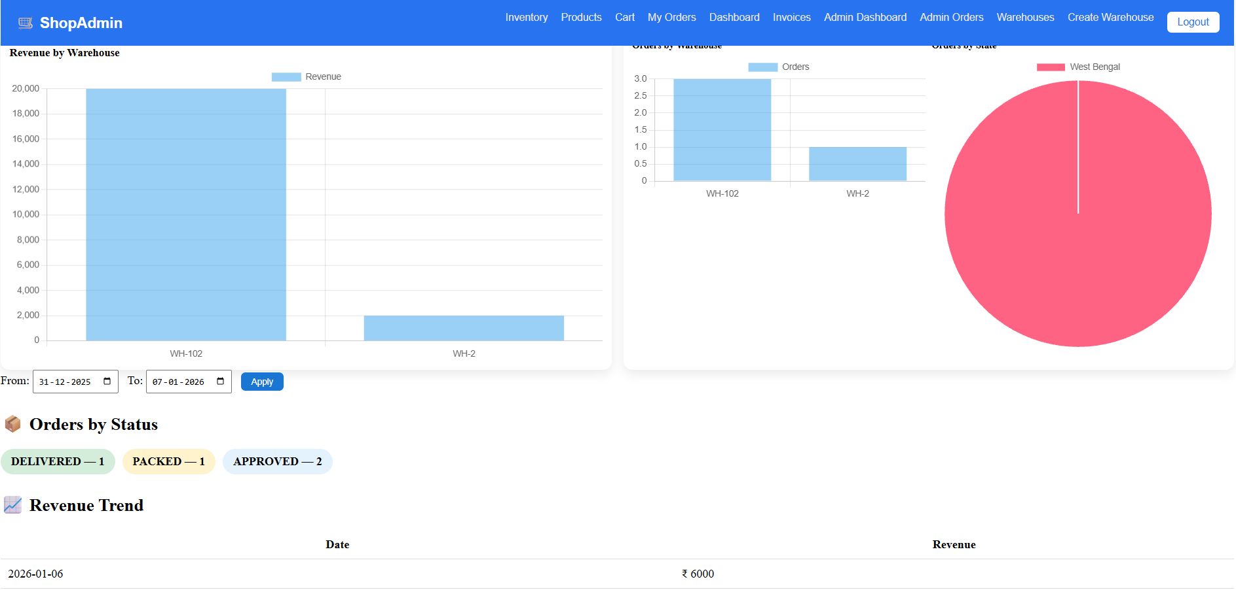
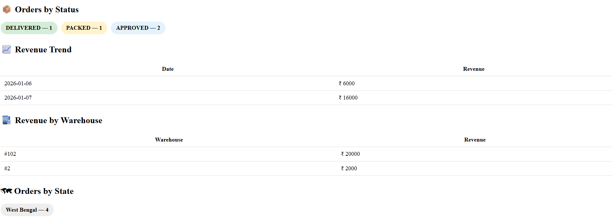
ADMIN DASHBOARD

Slide 20
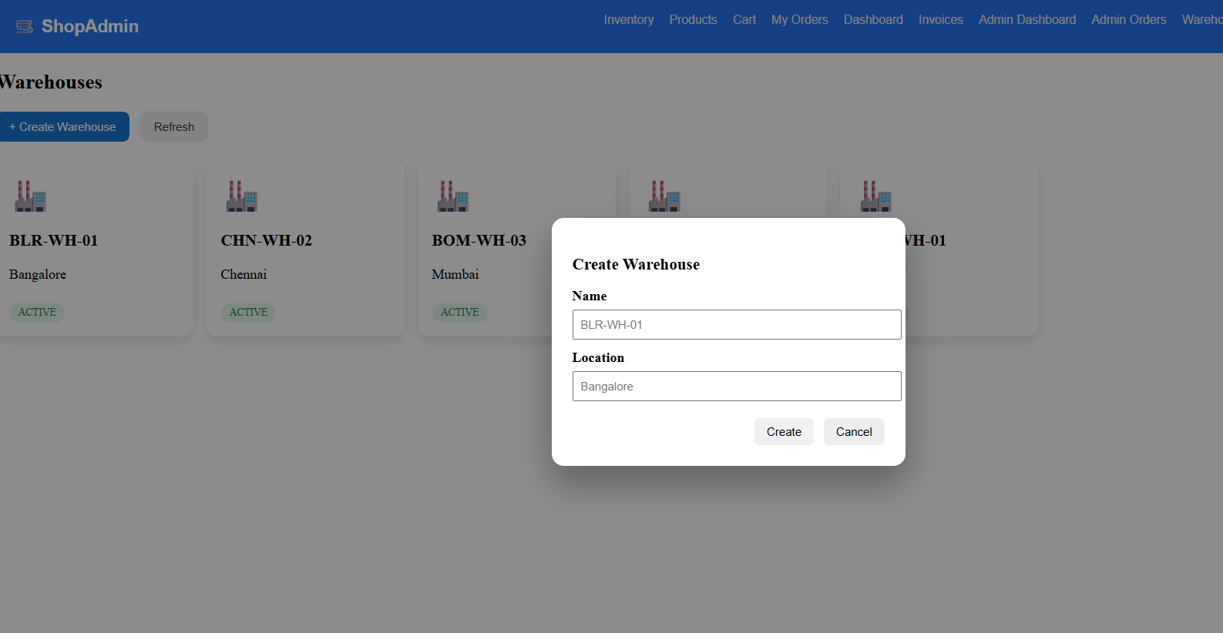
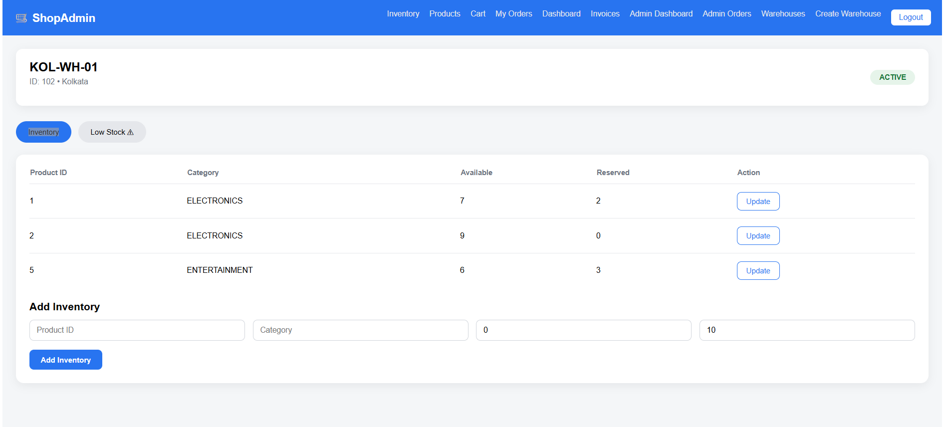
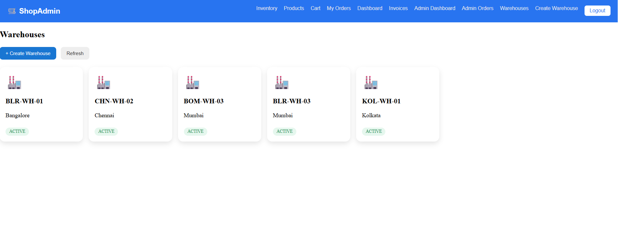
WAREHOUSES

Slide 21
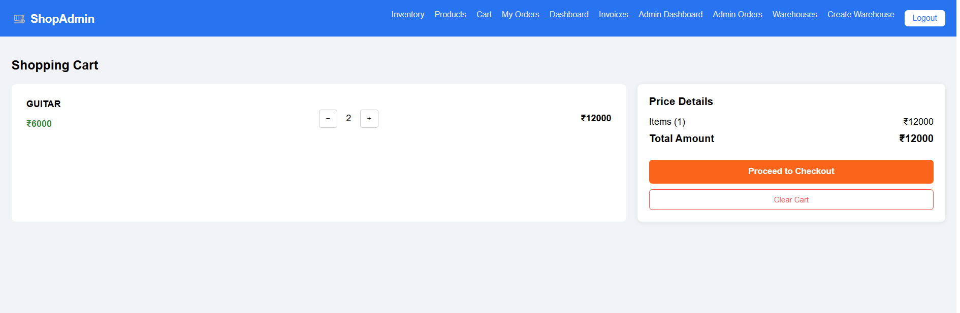
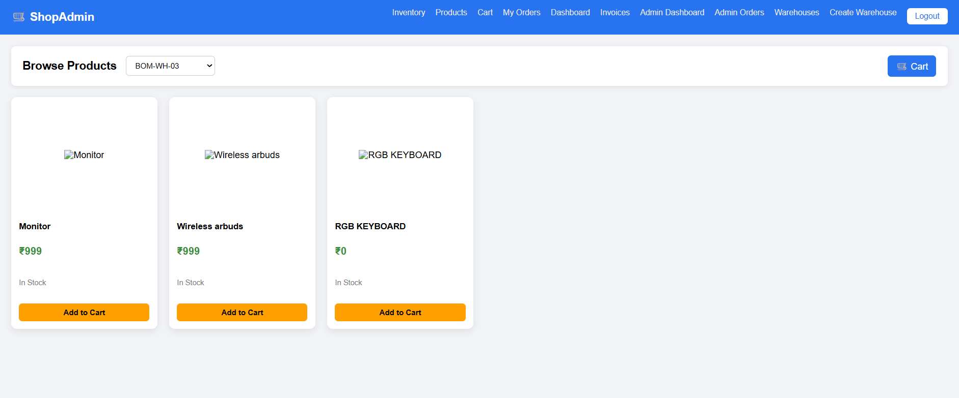
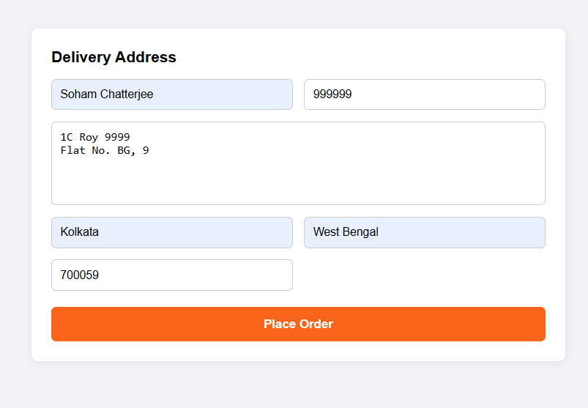
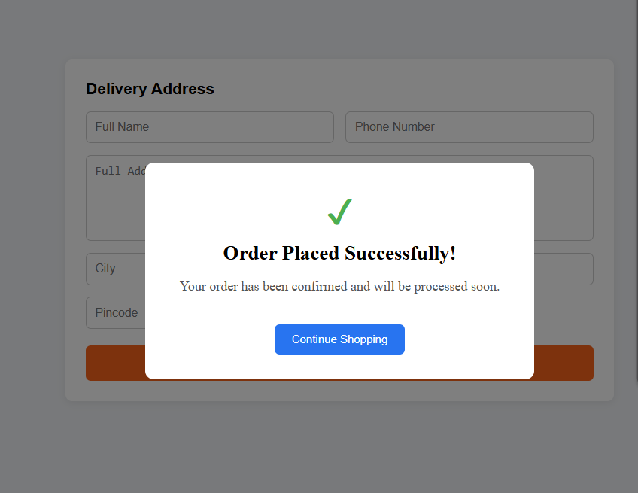
INVENTORY

Slide 22
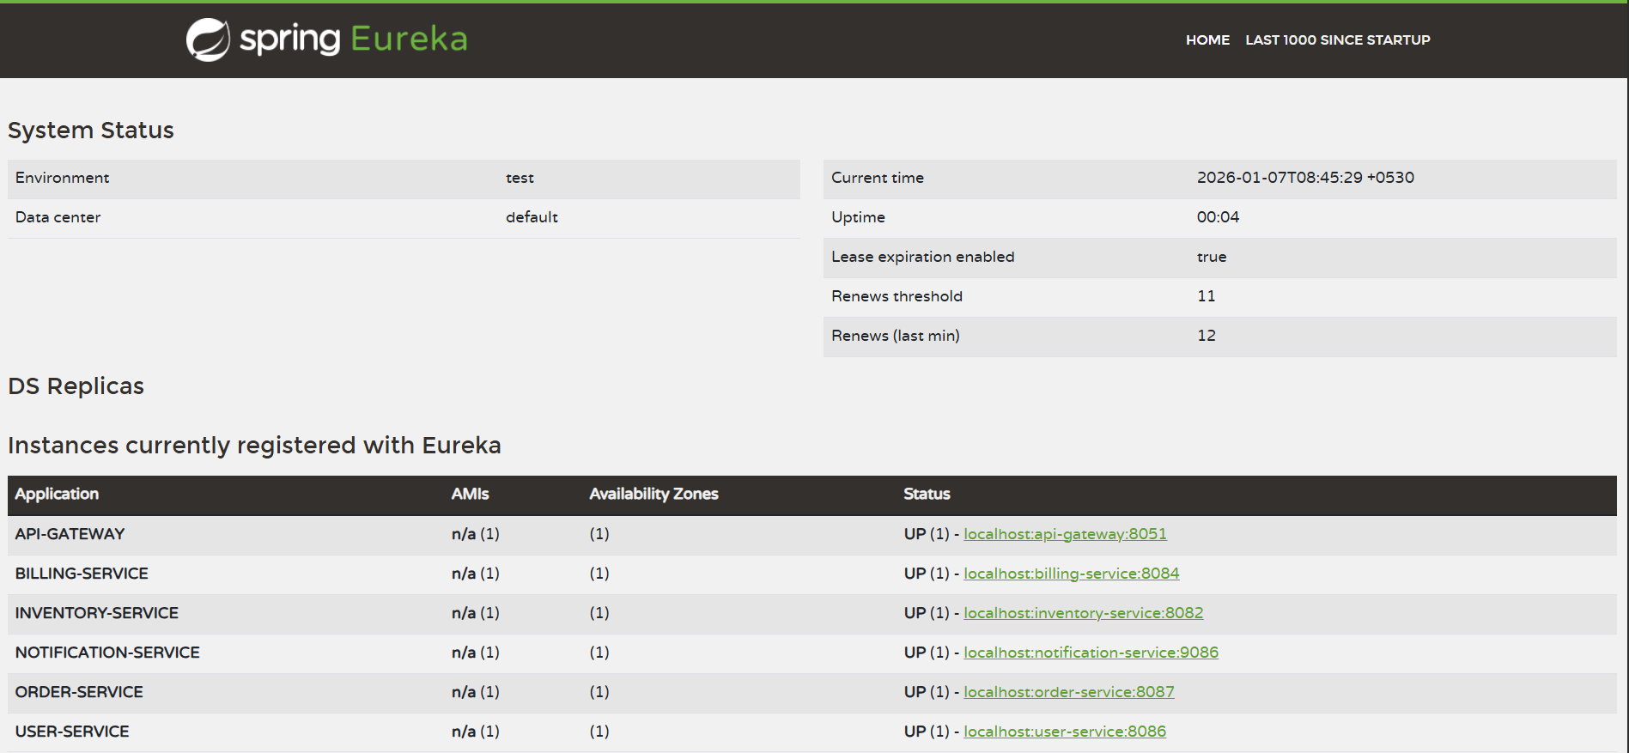
EUREKA-DISCOVERY-SERVER

Slide 23
Business Logic Summary – Smart Order & Inventory System
Secure Access: JWT-based authentication with role-based access (User / Admin) via API Gateway
Order Processing: Reliable order creation with inventory validation, price calculation, and invoice generation
Inventory Control: Stock reservation, commitment, and release to prevent overselling
Order Lifecycle: Controlled state transitions (CREATED → APPROVED → PACKED → SHIPPED → DELIVERED)
Admin Operations: Centralized order monitoring, status updates, and warehouse-level visibility
Analytics: Real-time insights on orders, revenue, status distribution, and warehouse performance
Notifications: Event-driven email alerts using Kafka without blocking core workflows
Fault Tolerance: Graceful handling of failures in billing and notifications
Scalable Design: Microservices with OpenFeign for sync calls and Kafka for async communication

Slide 24
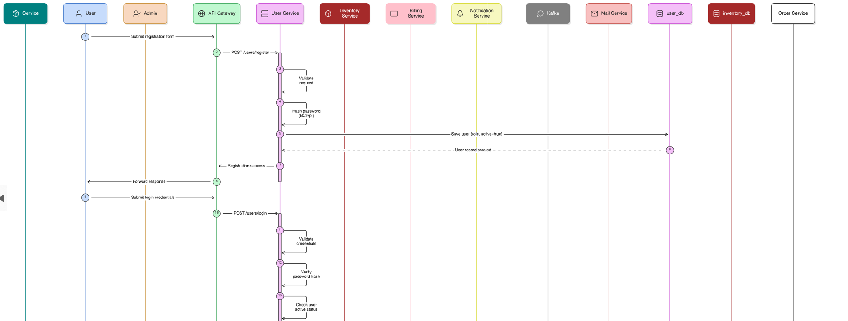
SEQUENCE DIAGRAM

Slide 25
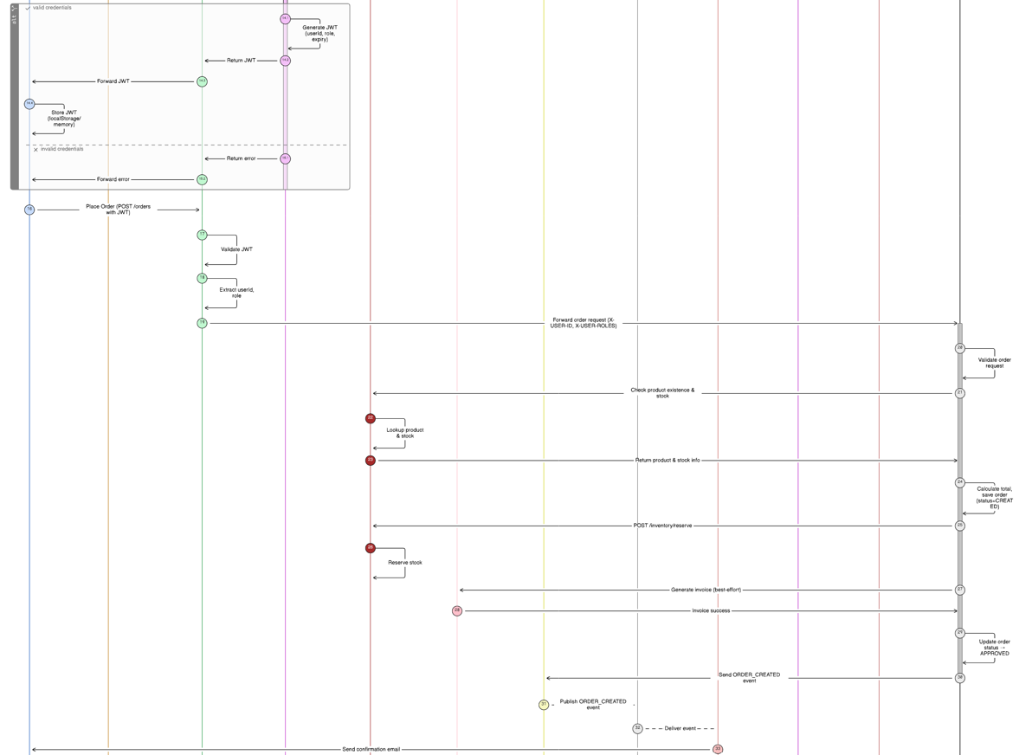

Slide 26
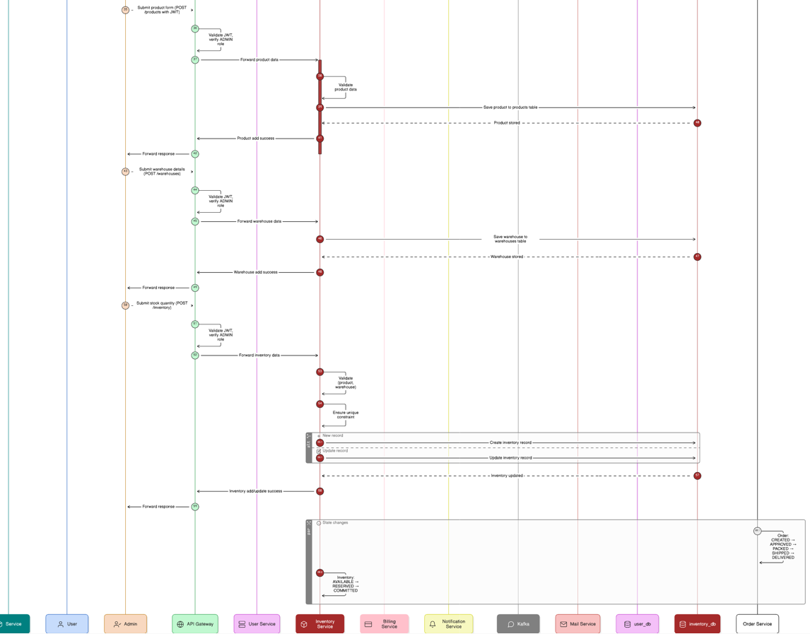

Slide 27
THANK YOU

